Slide 1
Testimony Classifier and Fact Dispenser
To assist legal minds and news media in their quick search for relevant testimony of facts

Slide 2
Dataset:
Congressional testimony transcripts from
https://www.congress.gov/congressional-record
Files were downloaded in pdf format then converted into txt using Adobe.

Slide 3
Problem:
Unreliable speech from public officials and news networks have reached a head in our nation.

Slide 4
How can this be helped?
News outlets, law offices, researchers, as well as others have an innate desire to be able to easily find relevant information within current, past, and future cases on the fly (immediate basis).
The purpose is to allow cross-referencing multiple testimonies and other public speech for inconsistencies and inaccuracies over time.

Slide 5
Solution:
Collect testimony, commentary, etc. from a target witness or person over years in the past to feed into our classifier. The A.I. will classify the data and allow for future comments and testimony to update the database as well as compare to existing testimony.

Slide 6
Why?
As one can imagine, having such a tool at your disposal during an interview can be powerful in challenging testimony. This could broaden out to public statements made over news networks, social media, etc. to combat the misinformation propagated as of late.

Slide 7
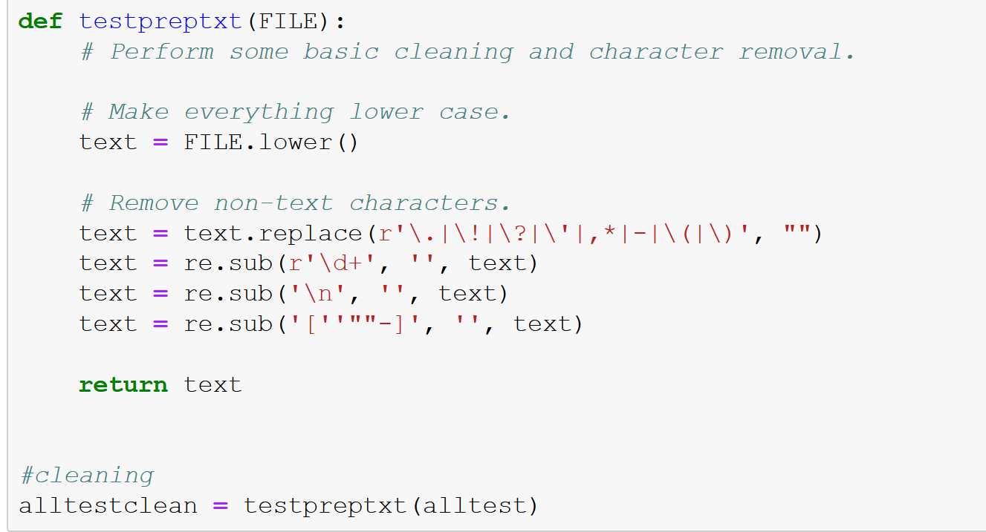
Data Cleaning:
Utilizing functions as well as stopwords (not shown) was key to help reduce the text into easier to process information.

Slide 8
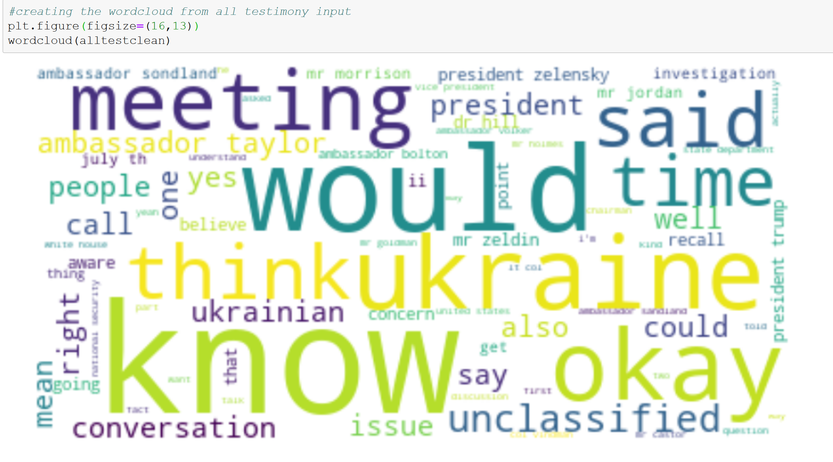
Exploring the Data with WordCloud:

Slide 9
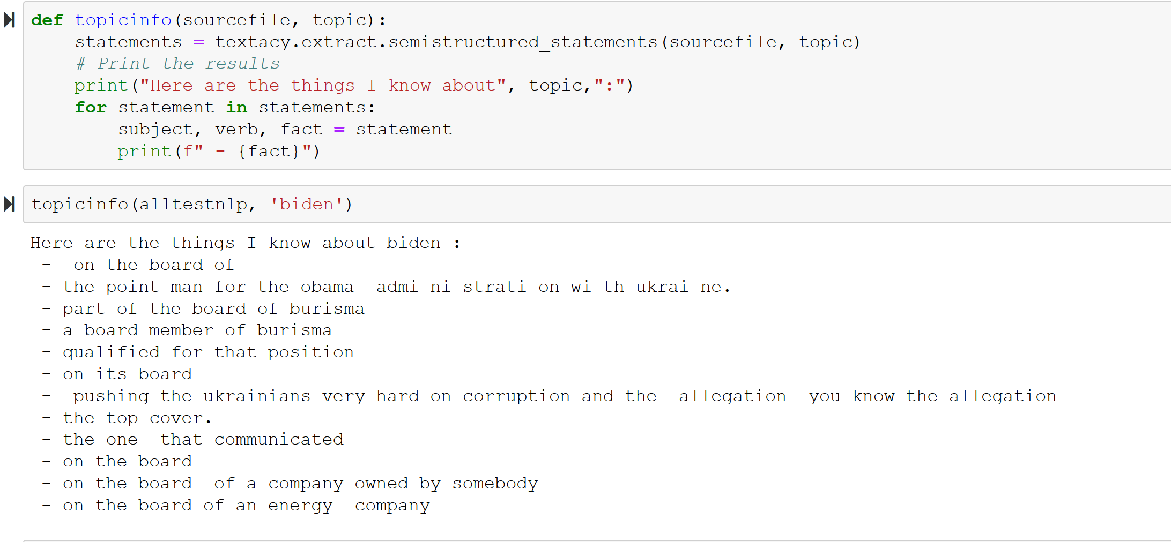
Fact Machine:

Slide 10
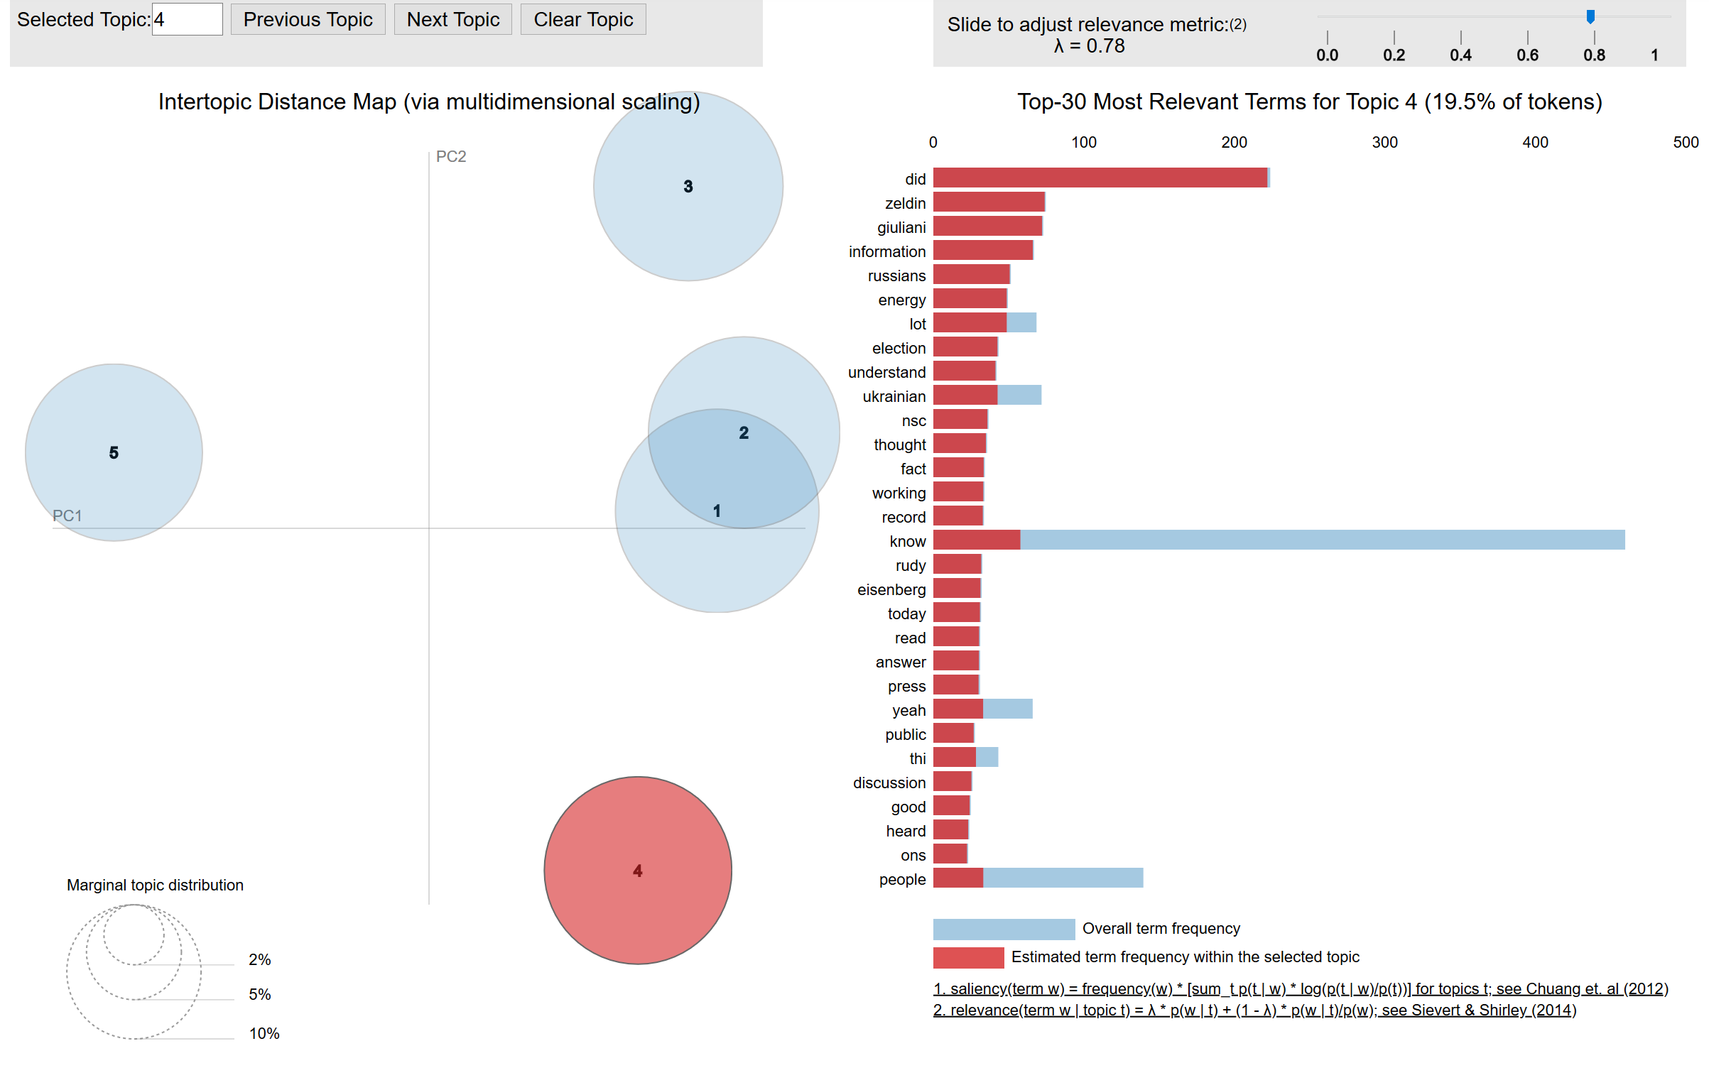
Topics and Visualizing:

Slide 11
In the Future…
Not only could AI be an effective tool in ensuring the accountability of truth to supersede all else but, we could create a subscription service to which news outlets and other researchers subscribe to have access to the neural network classifier utilizing datasets collected. Future upgrade the subscription service could use the large datasets to run personality analyses on anyone with a public social account. The benefit of this could target human resource prospecting applicants in hiring, negotiations between individuals/companies/foreign leaders, as well as other beneficial applications not listed here.

Slide 12
Thank you!

